Slide 1

Manual for general introduction and safety instructions

Slide 2
Instructions obligatory
All persons working in the iFZ must receive basic instructions before starting their work
For some areas, the responsible project manager must give specific instructions
The safety certification is valid for one year
Essential for ensuring good scientific practice

Slide 3
Secrecy
Persons working in the iFZ are sworn to secrecy with regard to facilities and activities in the iFZ
Information about laboratory or safety areas must not be communicated externally

Slide 4

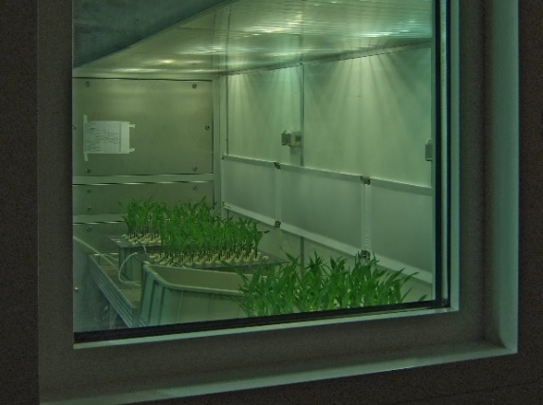
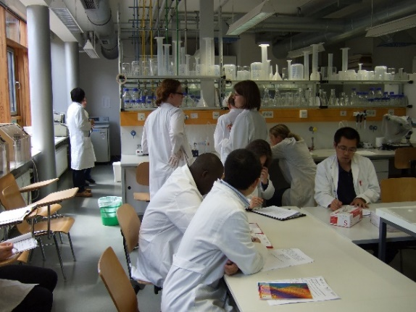
Secrecy
photographs inside iFZ buildings are only allowed with permission from the respective head of the area being photographed AND of any people who are photographed

Slide 5
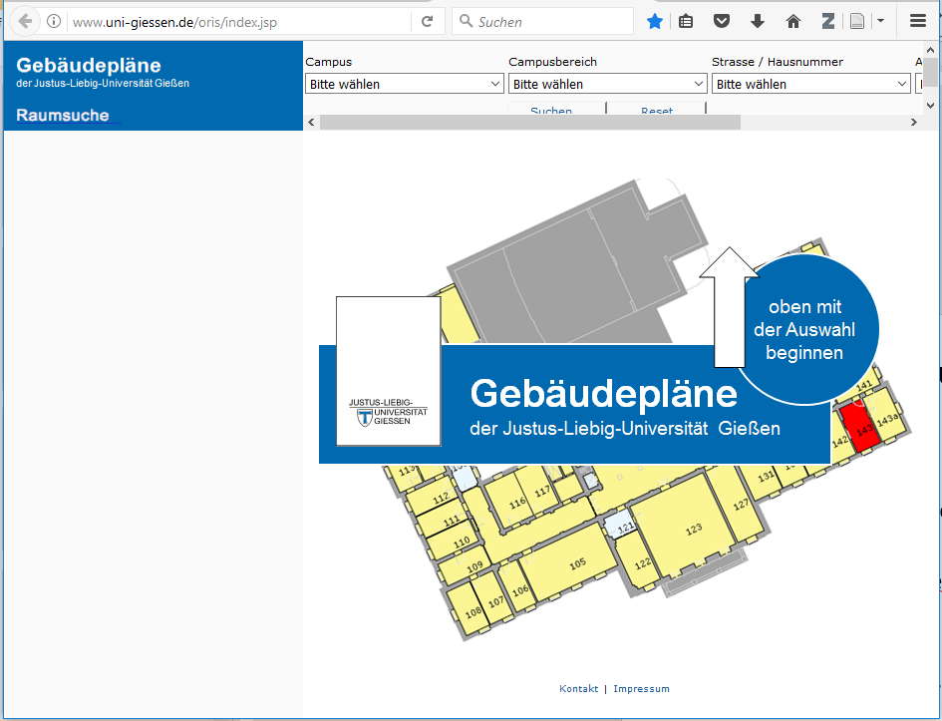
iFZ room denominations
B Office
L Lab
M Multifunctional
U Underground
H separate buildings

Slide 6
iFZ room access
Which room | Who decides about access
Room belonging to a professorship | Professor
iFZ common facility | Managers of iFZ common facilities
Technical facility | JLU administration

Slide 7
iFZ key system
Your digital key card is either a personalized staff card („Mitarbeiterkarte“), a student card or a non-individualized key card („Gastkarte“).
Key cards must be activated daily, before entering the building.

Slide 8
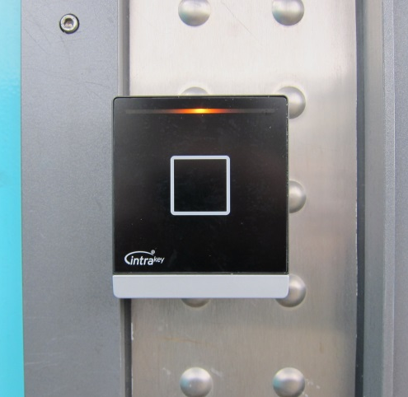
Opening iFZ doors
Activate card daily before entering the iFZ building (activation lasts until 24:00)
Press card onto activator at iFZ entrances for 2-3 seconds. The
first beep indicates start of reading, the
second beep indicates onset of access code writing, the third beep indicates the completion of the activation process.
If the card is removed before the third beep, the programming is incomplete and must be repeated for successful activation.

Slide 9
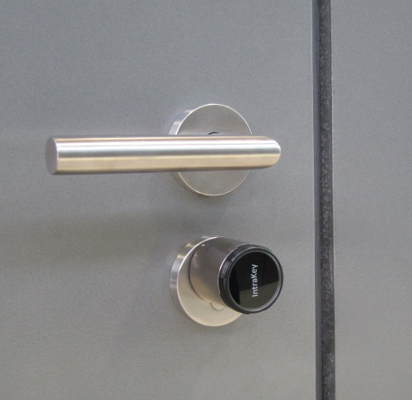
Opening iFZ doors
Room access
Hold key card close to the front of the lock cylinder below the door handle. The lock flashes a green light as soon as access is provided.
Turn lock to open like a mechanical key.
Lock the doors by the same routine.
An alarm beep after opening indicates a low lock battery - please notify the „Hausmeister“ (room/email?) so that he can replace the battery

Slide 10
Safety|Security Zones
Strangers are not permitted to enter the iFZ with you through the controlled doors.
Never work alone in iFZ laboratories and facilities outside of office hours.
Contractors and JLU service members must contact persons in charge daily BEFORE onset of work.
Always follow the safety directives of your responsible project manager or person in charge.

Slide 11
JLU organization
JLU President
JLU Administration
  Construction, maintainance („Bau und Technik“)
  Facility management („Liegenschaften“)
  Personnel management
Faculties („Fachbereiche“)
  Departments („Institute“)
    Professorships („Professuren“)
Centres/Special Infrastructures („Zentren“)
    iFZ Professorships

Slide 12
Responsibilities
JLU: Präsident
Department: Institute Director
Professorship: Professor/Chair
Central facility (e.g. isotope lab, growth chambers, greenhouses): Respectively head of central facility

Slide 13
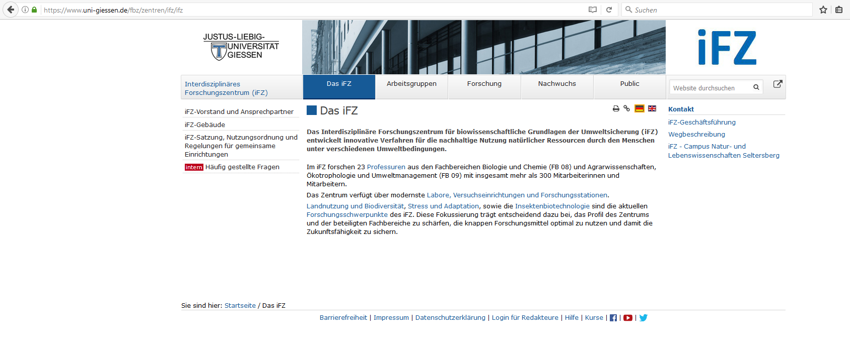
iFZ statutes and regulations
[official version available in German only]

Slide 14
Lab Rules
Eating, drinking and storage of food is absolutely prohibited in all laboratories.
Contractors, JLU technicians → Please use iFZ cafeteria
iFZ staff → please use iFZ social rooms (Wintergarten)
Please use cosmetics only in sanitary facilities, not in laboratories
When leaving laboratories you must disinfect and wash your hands.
Hand moisturiser is available in labs for use after washing.

Slide 15
Lab Rules
Lab coats are obligatory in all iFZ labs
Protective clothes must not be worn outside laboratories
Open shoes or bare feet are not permitted in laboratories
Avoid long scarfs, tie up long hair
Do not wedge or otherwise fix the fire protection doors to keep them open
Windows must remain closed at all times (to protect the environment outside and maintain the automated room ventilation)
Do not work in the lab with open wounds

Slide 16
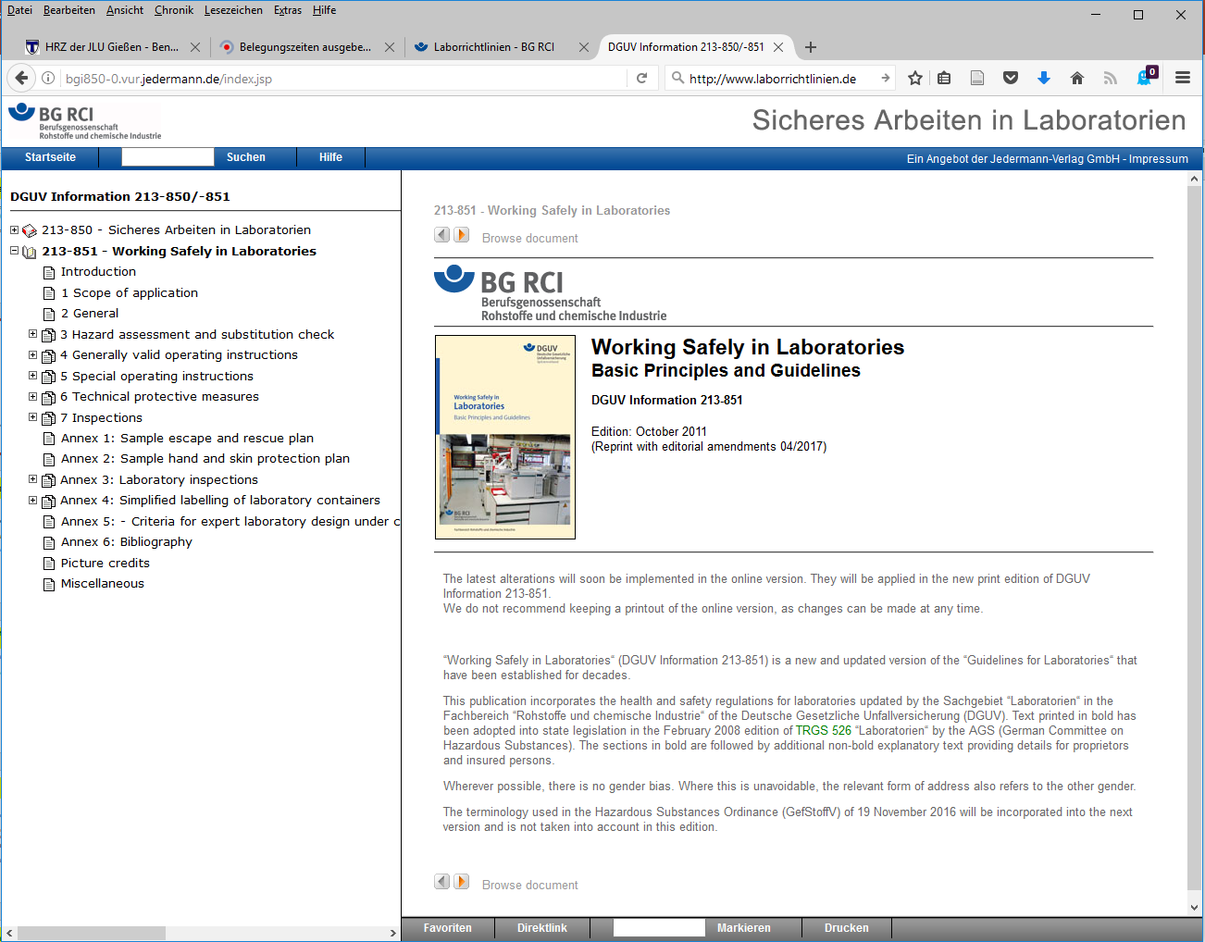

Slide 17
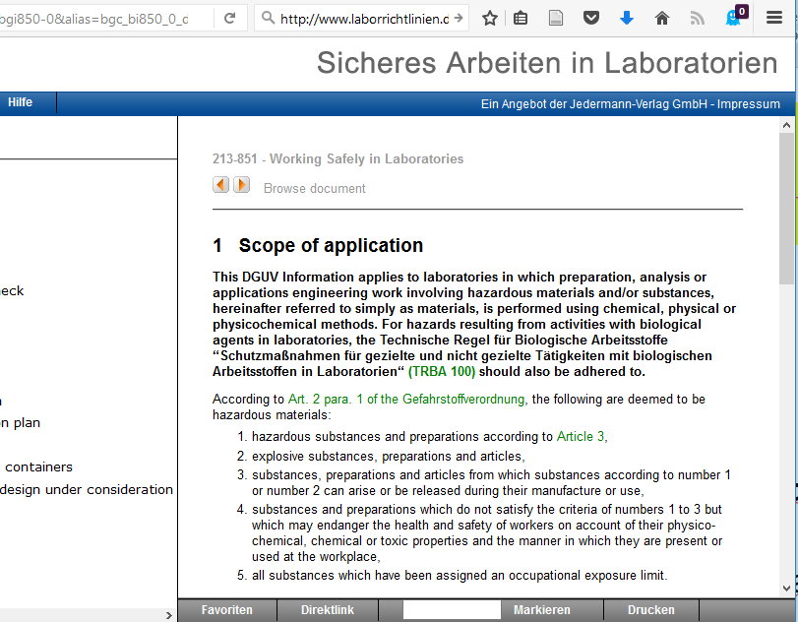

Slide 18
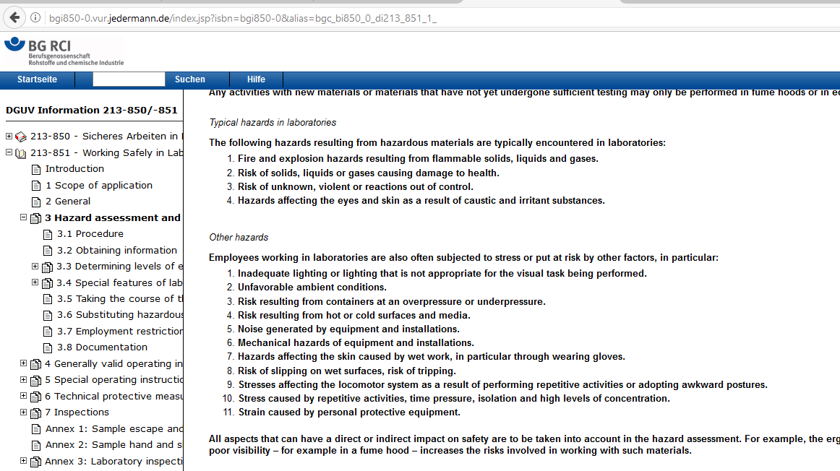

Slide 19
Risk levels for infectious agents and GMOs
Level | Risk to human health and environment | Spreading among human population | Prevention/ treatment
S1 | none | ---- | ----
S2 | low | improbable | possible
S3** | moderate NOT air-borne | rather unlikely | possible
S3 | moderate air-borne | possible | possible
S4 | high | pandemic! | NOT possible

Slide 20
Genetically Modified Organisms (GMO)
a GMO is an organism with a genome that has been modified in the laboratory.
GMO organisms do not occur naturally and in Germany their use is restricted to laboratories.
Examples:
Modified bacteria
Cells infected with modified bacteria or viruses
Modified plants or laboratory animals

Slide 21
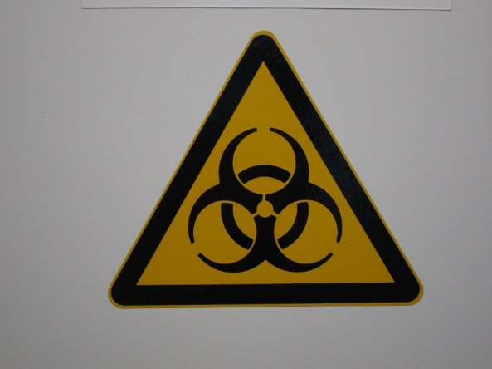
Biosafety
Protection of staff from hazards working with biological agents
Regulations
German Genetic Engineering Ordinance
(Gentechnikgesetz und GenTSV)
German Ordinance on Biological Agents
(Biostoffverordnung)
German Infectious Disease Control Act and
the Animal Pathogen Ordinance
Technical rules (e.g. TRBA 100 protective measures in laboratories)
Designated project managers are responsible for specific areas

Slide 22
Genetic Engeneering Facilities in the iFZ
Gentechnische Anlage | Sich.stufe | UGI | Projektleiter | BBS
Institut für Mikro- und Molekularbiologie L251, Nutzung nur unter S1-Bedingungen | (S3) S1 | 80 | Klug, Prof. Dr. Gabriele | Dr. S. Rahlfs
Institut für Mikro- und Molekularbiologie L230, L231, L232, L233, L234, L235, L236, L245, L246, L247/248, L249/L250, M233, M234, M235, M236, M237, M238, M239, M244, M245; L021; U170, U176 | S1 | 81 | Klug, Prof. Dr. Gabriele | Dr. S. Rahlfs
Institute für Phytopathologie und Insektenbiotechnologie L335, L336, L337, L338, L347, L348, L350, L357, M328, M329, M330, M331, M336, M337, M338; M420, M423, L423, L431/432, L433, M422; L349, M421, M422a | S1 | 82 | Dr. Aline Koch | Dr. C. Obermeier
Institut für Pflanzenernährung L034-L036, L037, L038, L039, L040, L049, L050, L051, L052, L053, L054, L055, L056, M034, M035, M042, M043; L131, M129; U150 | S1 | 83 | Prof. Dr. Till Schäberle | Prof. Dr. U. Wenzel
Institut für Pflanzenbau und Pflanzenzüchtung I L320/321, L322, L323, L324, L325, L327, L332, L333, L334, M318, M319, M320, M321, M322, M323; L420, L421, L422 | S1 | 84 | Dr. Christian Obermeier | Imani, Dr. J.
Institut für Angewandte Mikrobiologie L017; L 019 | S1 | 85 | Kämpfer, Prof. Dr. Dr. Peter | Dr. Stefan Rahlfs
Institut für Pflanzenbau und Pflanzenzüchtung II Biometrie und Populationsgenetik L203, L204, L205, M212, M211 | S1 | 86 | Prof. Dr. Rodney Snowdon | Imani, Dr. J.
Biotechnikum mit Klimakammern H023, H031, H042, H024-H030, H035-H041,H012-H015, H017-H020, Flure H011, H021, Putzraum H032, Toiletten H033, H034; H004, H005, H006, H010 | S1 | 87 | Dr. Jens Steinbrenner | Dr. Stefan Rahlfs
Institut für Ernährungswissenschaft, Biochemie der Ernährung L147, L148, L151, L152, L153, M128, M136 | S1 | 88 | Becker, Prof. Dr. Katja | Prof. Dr. U. Wenzel
iFZ Gewächshausanlage K1 - K8, K9 - K15, Räume R1, R3, R4a, R5, R5a, Flur R6 | S1 | 89 | Dr. Aline Koch | Dr. Stefan Rahlfs
Forschungshalle IFZ, Kombination von Labor- und Gewächshausbereich | S1 | 90 | Imani, Dr. J. | Dr. Stefan Rahlfs
Institut für Ernährungswissenschaft, Biochemie der Ernährung: L149, L150 | S2 | 91 | Becker, Prof. Dr. Katja | Prof. Dr. U. Wenzel
Professur für Molekulare Ernährungsforschung L306, L307, L308, L318 | S1 | 92 | Fitzenberger, Dr. Elena | Becker, Prof. Dr. Katja
Institut für Phytopathologie (Praktikumslabor) U144, U152 | S1 | 93 | Imani, Dr. Jafargholi | Dr. Stefan Rahlfs
Institut für Tierernährung und Ernährungsphysiologie L116/L116a, L117, L118, L119, M118, M120, M129 | S1 | 94 | Wen, Dr. Gaiping | Prof. Dr. U. Wenzel
Institut für Tierernährung und Ernährungsphysiologie, Stoffwechsellabor Räume 11, 12, 13, 15/17 | S1 | 95 | Wen, Dr. Gaiping | Prof. Dr. U. Wenzel
Institut für Ernährungswissenschaft, Lebensmittelwissenschaft L132, L133 | S1 | 96 | Wen, Dr. Gaiping | Dr. Stefan Rahlfs
Institut für Insektenbiotechnologie L352, L353, L355, L439, M422a, M428, M429 und M430 | S1 | 97 | Dr. Kwang-Zin Lee | Dr. W. Wende

Slide 23
Genetic Engineering – cultures
All cultures (including GMOs) must be labelled with:
- date
- identification/organism
- owner
All cultures must be stored within designated areas
Any unlabelled viable materials must be treated as potential GMOs and handled in accordance with these conditions
Notify the Lab Manager immediately if you find unlabelled materials

Slide 24
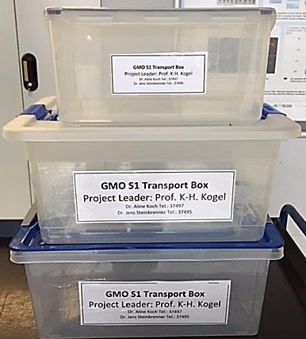
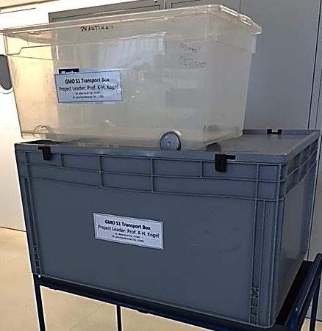
Genetic Engineering – Transport
GMOs must always be transported in closed, labeled containers

Slide 25
Genetic Engineering – Waste
All waste contaminated with GMOs must be autoclaved
  Waste:
  All solid and liquid waste contaminated with GMOs
  Plant material (all propagative parts)
  Potting soil
The autoclave must only be used by trained personnel
Decontamination of GMOs must be documented
After autoclaving, the waste can be disposed in a normal manner

Slide 26
Genetic Engineering – Disinfection/Decontamination
If GMOs are spilled on the bench, floor etc :
  remove material with paper towels,
  autoclave waste,
  disinfect the area with Frekanol.
If GMOs are spilled on skin:
Disinfect with Sterillium
Always inform the responsible project leader
For details on desinfection of skin, (bench) surfaces, devices: see the safety directive ("Betriebsanweisung") in each lab: close to the door, pinned to the wall

Slide 27
Biological Safety - “Formblatt Aufzeichnungen”
The idea of “Formblatt Aufzeichnungen” is that the assembly / construction / features of the GMOs
(incl. vectors and procedures) must always be traceable
“Formblatt Aufzeichnungen” are fixed in each lab journal
The lab journal does not leave the institute

Slide 28
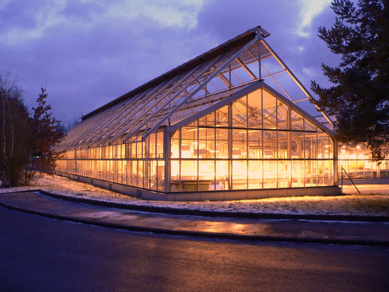
iFZ GMO plant growth facilities
Because of the different locations there are several INDEPENDENT biological containment facilities associated with the iFZ
  Dr. Jafargholi Imani
    UGI 90 Multifunktionshalle/Forschungshalle iFZ
    UGI 74 field station, ASW 44
  Dr. Aline Koch
    UGI 89 Greenhouse iFZ
  Dr. Jens Steinbrenner
    UGI 87 growth chambers Biotechnikum

Slide 29
General rules
New users must undergo a safety briefing (by an authorised project leader) before start of work and must read the appropriate manual of operations (“Betriebsanweisung”)
For each facility there is a specific, detailed manual of operations
Annual repetition of safety briefings is obligatory
The project leader (“Projektleiter”) responsible for GMO work in each facility
  must be informed before start of work (new cultures: S1?)
  must be provided with a documentation of all GMOs (he/she needs a complete list of GMO species in the facility for the annual re-evaluation of S1 level classification)
  Simplified documentation is possible for e.g. propagation of GMOs documented in other JLU Giessen GMO labs (UGIxx)
  (ask project leader for detailed instructions)

Slide 30
General rules for biological containment facilities
ALL new users must visit the JLU medical officer („Betriebsarzt“) when assuming work in a biological containment facility
Repeat medical checks are required every 3 years (to be recorded by responsible project leader)
Always keep doors closes if GMOs are present
Record all experiments with GM plants (owner, GMO type, objective, end of experiment/transportation into UGIxx):
list at cabin front doors, books in chambers
Label all plants and samples fully and non-ambigiously!
Lab coats are mandatory in biological containment facilities!
Only transport GMOs in closed, unbreakable, labeled boxes
Transport of flowering plants is not permitted!
Inactivate GMO material in autoclave
Control of pests/pathogens is mandatory
Eating, drinking, smoking or storage of food is absolutely prohibited in all biological containment facilities (S1/S2 areas, including corridors).

Slide 31
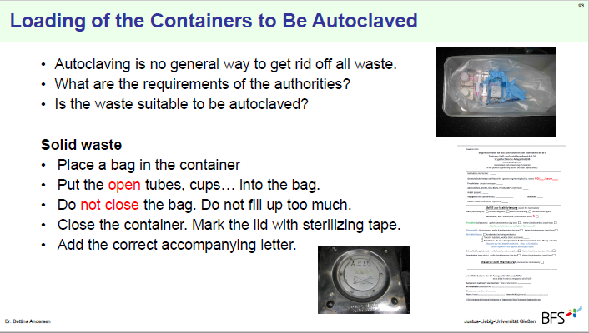
Waste Management

Slide 32
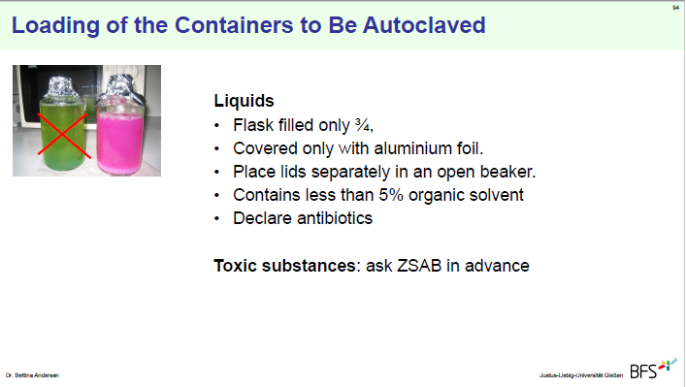
Waste Management

Slide 33
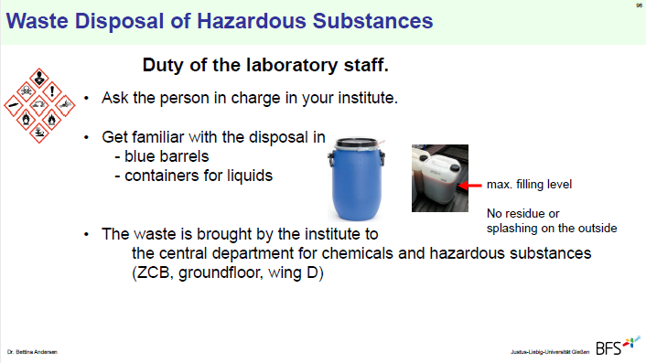
Waste Management

Slide 34
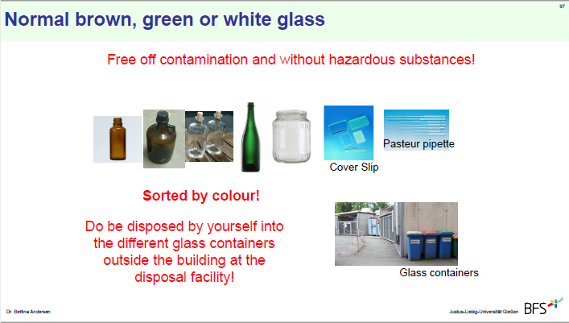
Waste Management

Slide 35
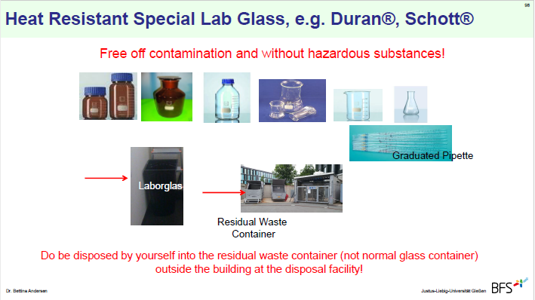
Waste Management

Slide 36
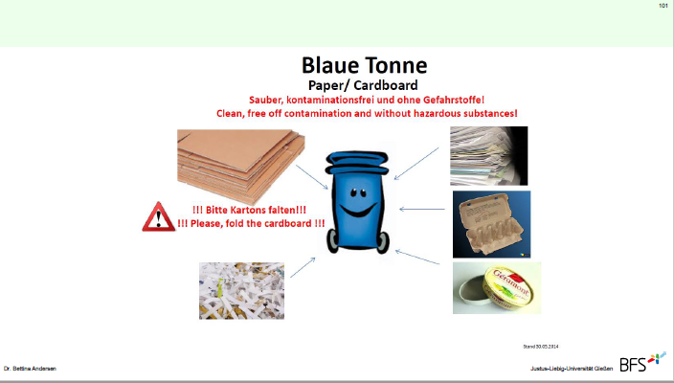
Waste Management

Slide 37
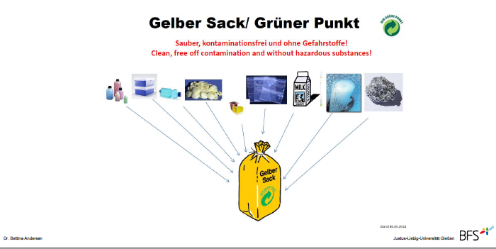
Waste Management

Slide 38
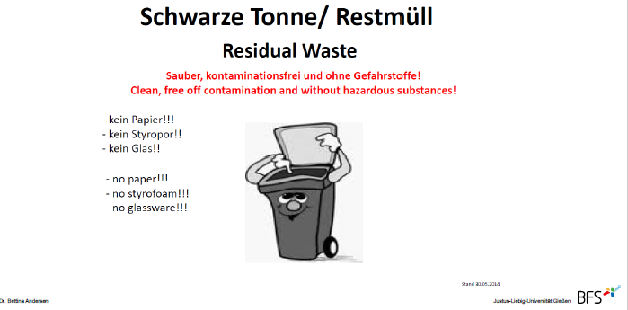
Waste Management

Slide 39
Tasks of cleaning staff
Cleaning of the hand washbasin
Cleaning of the floor
(contaminations must be removed by the cleaning staff only)
Emptying of the trash bins (household garbage)
Refilling of paper towels (lab staff refills disinfection dispenser)
NO disposal of hazardous waste

Slide 40
Maintenance in research areas
During maintenance work, laboratory work with potential hazards is prohibited
Only laboratory staff are permitted to open fridges, freezers and incubators.
Maintenance staff may ot touch laboratory equipment without the consent of laboratory staff.
Special protective clothing (coats or gloves) provided to maintenace staff must remain in the work area and must not be worn in the corridors.

Slide 41
In case of a lab accident
keep calm –
think first ?
then act !

Slide 42
In case of a lab accident
Identify the danger
Determine and prevent personal risk
Then warn other staff
Block and contain

Slide 43
In case of a lab accident
Avoid spreading contamination (such as GMOs, infectious agents, chemical hazards) onto door handles, telephone receivers, transportation containers, etc.
Immediately contact the person responsible for the facility or your safety officer
Serious incidents: clearance only after consulting JLU Safety Department

Slide 44
Emergency Numbers
In case of a medical emergency, call
112 FIRST AID
In case of a fire, call
112 FIRE BRIGADE
In case of a technical emergency or any serious technical incident, call 0641 - 99 - 12666 (12666 from any JLU phone), available 24 h / 365 days a year
In case of a crime, call 110 POLICE

Slide 45
Emergency Calls
If available, use your mobile phone to be able to keep contact with the emergency team while moving inside or outside the building
Emergency calls are possible from all iFZ telephones
Emergency calls [in Gießen] are possible in both German and English language
Please tell the emergency/ambulance coordinator:
“Pickup at Lieferanteneingang, the main entrance at the turnaround”
Instruct someone to meet the ambulance at the main (red) entrance at the rear of the iFZ
Tell emergency team: JLU insurance “Unfallkasse Hessen”

Slide 46
JLU Work-Health-Environment Management System (AGUM)
AGUM-Notfall-Organisation (mostly in German)
www.uni-giessen.de/org/admin/dez/b/3/agum/notfallorga
under construction

Slide 47
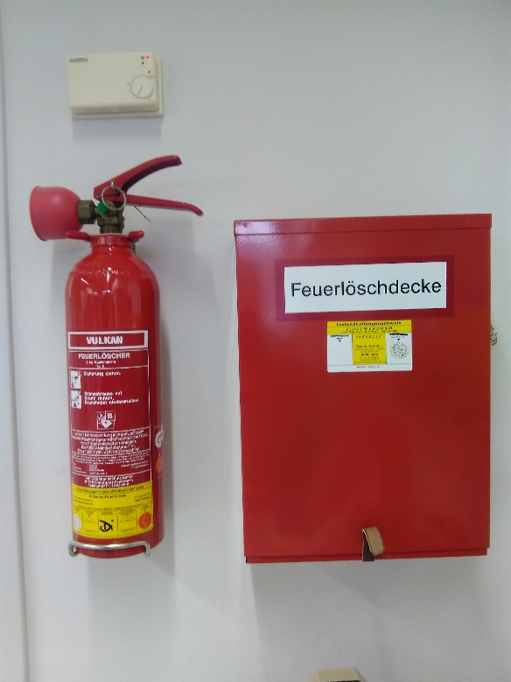
In case of fire
Try to extinguish the fire
TAKE NOTE!
Where is the firefighting equipment located? (fire extinguisher, fire blankets)
How to use the firefighting equipment?

Slide 48
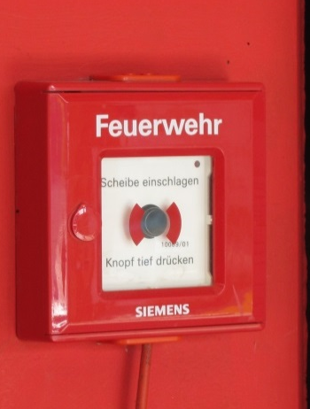
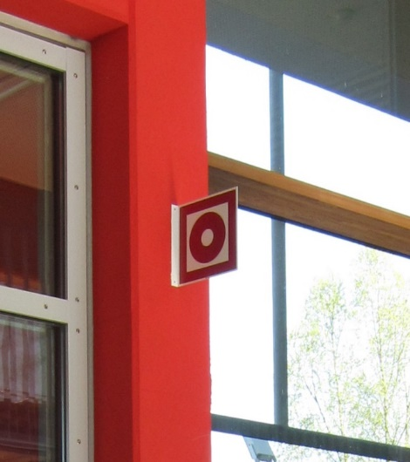
Raising a fire alarm
TAKE NOTE!
Become acquainted with the position of the push-button fire alarms

Slide 49
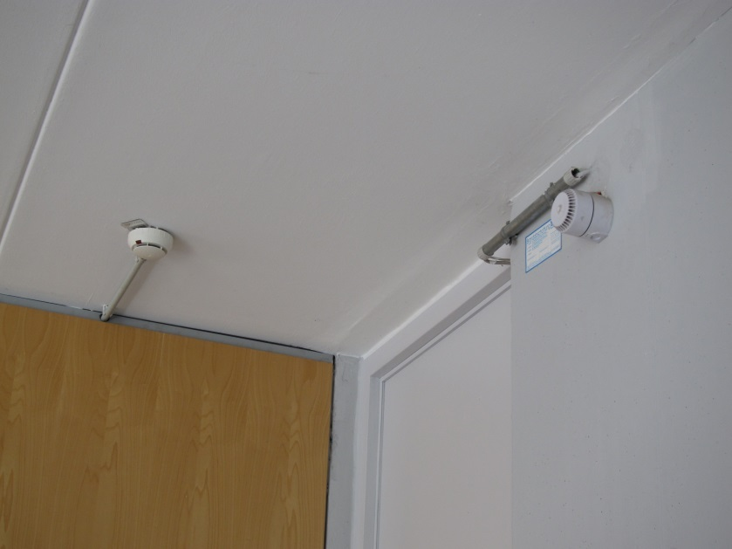
Automatic Fire Alarm
Smoke (or welding) triggers the automatic fire detectors on the ceiling
In this case the fire alarm starts automatically and the fire department is contacted automatically

Slide 50
Hearing an alarm
keep calm –
think first ?
then act !

Slide 51
Hearing an alarm
Bring yourself to safety
Assist handicapped persons
Consider securing your workplace, if still possible
Leave the building immediately!
Follow escape routes
Do NOT use an elevator! You risk suffocating!

Slide 52
What to do before evacuation
If time permits, secure your workplace (e.g. close bottles with hazardous substances, close fume hoods, extinguish open fire)
Only use the emergency stop for gas or electricity in case of acute hazard (e.g. fire IN the respective lab)
Unnecessary use of the emergency stop for gas or electricity can lead to additional hazards for yourself and for the emergency personnel!

Slide 53
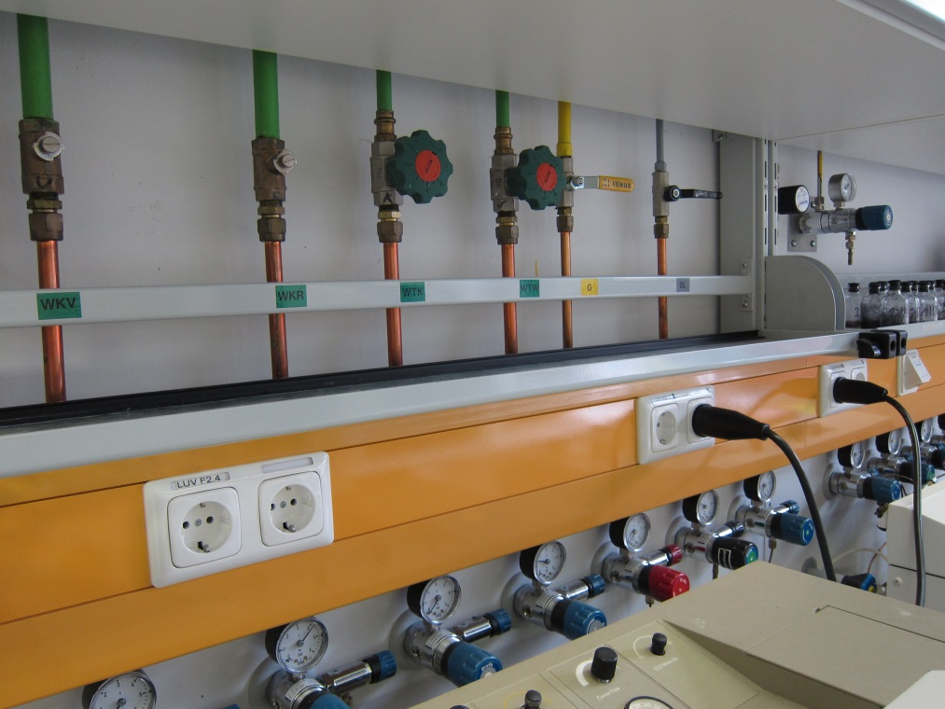
Technical Emergency: Water and Gas
Shut-off valves are located under top cupboard

Slide 54
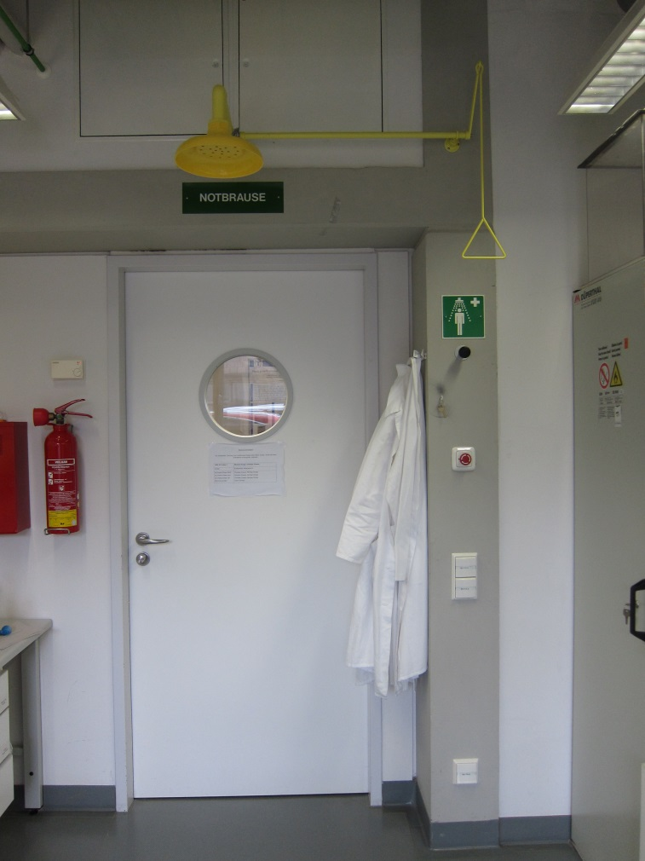
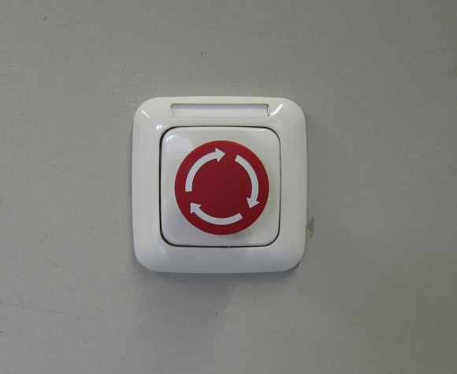
Technical Emergency: Electricity
Emergency button
Inside the lab,
close to the door

Slide 55
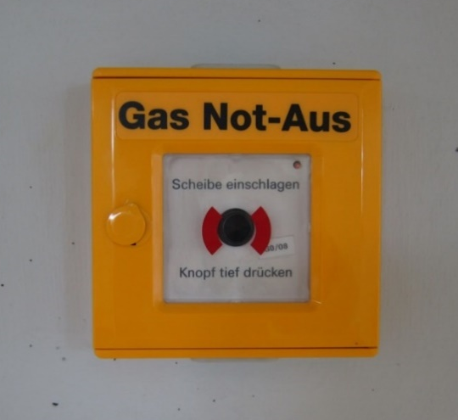
Technical Emergency: Gas
Emergency buttons to shut down gas supply
are located in the corridor
[use any tool to break the glass;
do not use hand or ellbow,
serious risk of injury]
The button switches off
central gases
gases inside gas safety cabinets
In the entire block of the building (C, D, E or F)
Emergency buttons can only be reset by JLU technical worhshop staff (Bereichswerkstatt)

Slide 56

Emergency body showers in labs
Emergency body shower
located at all laboratory doors
To use the emergency body shower pull down the handle,
to close push the handle upwards.
There is no floor drain installed in iFZ labs.
The water released must be removed manually – see the person in charge of the lab.

Slide 57
Eye showers in labs
Eye shower at the wash basin - pull out!
Changing rooms and showers are available in the basement (U1) (stairway opposite the main entrance / „Poststelle“)

Slide 58
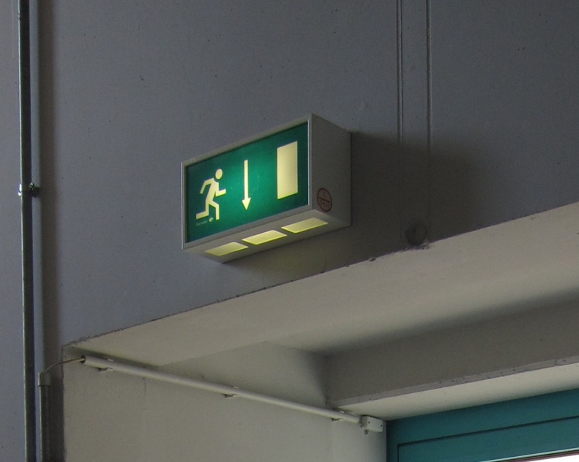
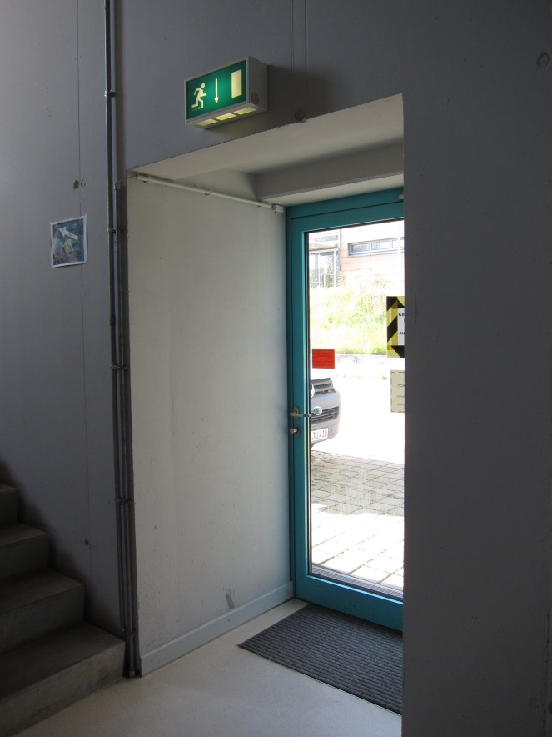
Escape Routes
Access must never be blocked

Slide 59
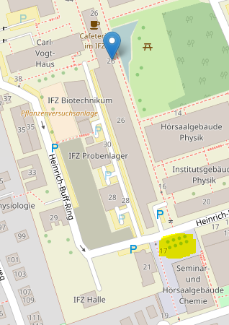
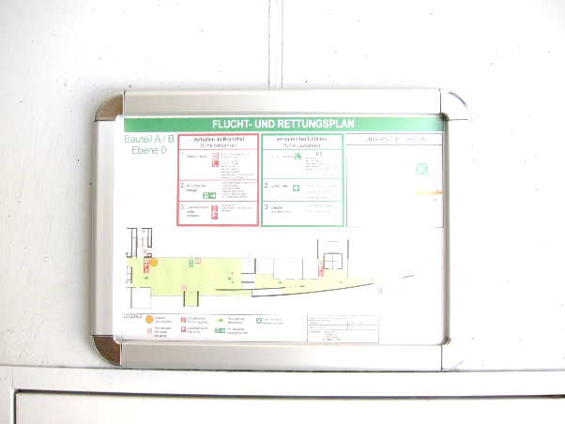
Escape and Rescue Plan
iFZ meeting point for all iFZ groups:
Courtyard of new chemistry building (Vorplatz Neue Chemie)

Slide 60

At the Meeting Point
Each team (institute/professorship)
gathers at the Meeting Point
Check: anyone missing?
PRACTICE:
Where is our meeting point?
How do we check if anyone is missing?

Slide 61
Re-entering the iFZ
NEVER reenter the building when the emergency alarm is sounding
Permission to re-enter the buildiung is granted EXCLUSIVELY by the fire department, the JLU safety department or persons authorized by either of these

Slide 62
First Aid
Stop working immediately
Apply appropriate first aid procedures
Call emergency, if necessary, – if not
Visit „Durchgangsarzt“ (physician in charge for JLU members) for treatment and formal diagnosis
Immediately notify the responsible project manager
Injuries without a follow-up visit to the medical doctor have to be documented in the accident book („Unfallbuch“) of the respective iFZ unit

Slide 63
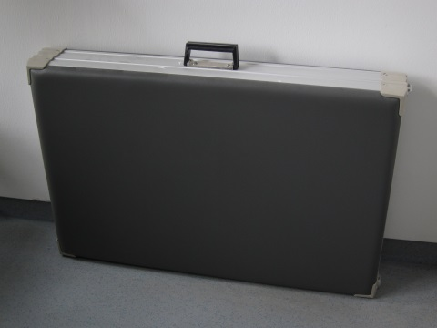
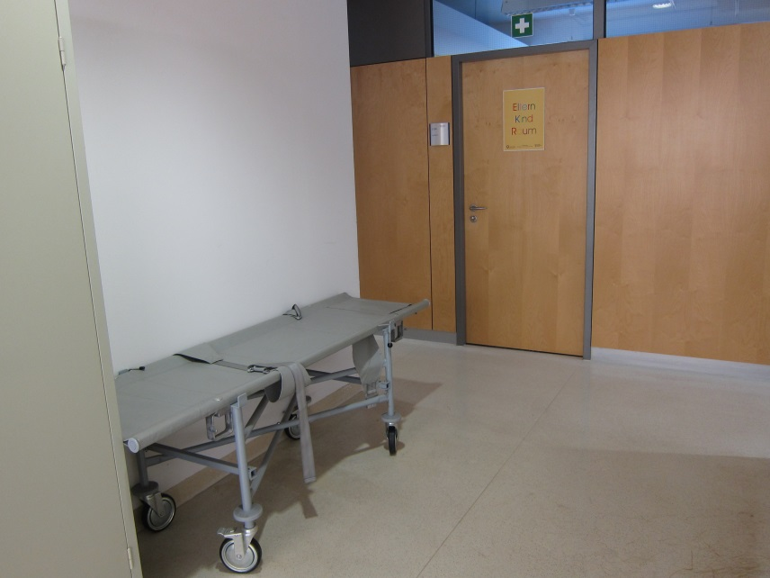
First Aid Stretchers
iFZ ground floor:
Mobile stretcher outside B004
Portable fold-up stretcher
inside B003
[where else close
to your institute??]

Slide 64

First Aid Kits
First aid kits
are indicated by a white cross on a green background
Emergency information:
Emergency calls numbers,
names of first-aid responders and locations of portable medical units can be found at institute displays

Slide 65
Trouble: Report after incident to
iFZ staff:
Professor
Project leader of S1 / S2 area or isotope lab
iFZ management Tel. 17500
JLU administration / HRZ staff:
Supervisor
Contractor staff:
Contact person at JLU

